Slide 1
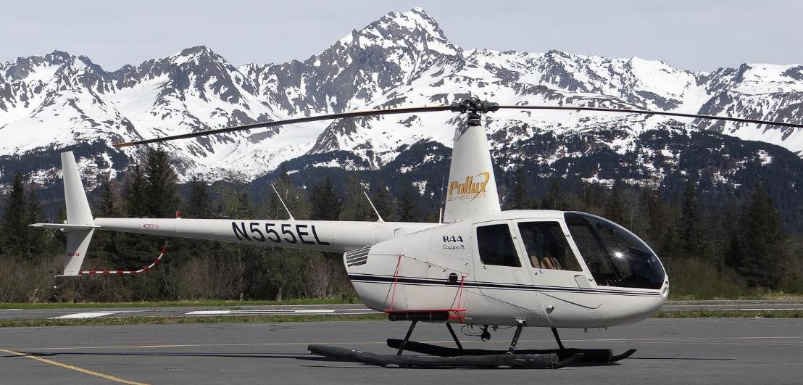
UAS* vs. Conventional Aircraft Airborne Collisions:
Update as of October 10th, 2021

Slide 2
Drone vs. Conventional Aircraft events in the NAS
Sep 21, 2017 Staten Island, NY UH-60s vs DJI; damage Confirmed
Feb 9, 2018 Kauai, HI EC-130 vs UKN; slight damage Probable
May 29, 2018 Aurora, OR C-170 vs UKN; damage Probable
Aug 10, 2018 Driggs, ID Balloon vs DJI; no damage Confirmed
Dec 4, 2019 Los Angeles, CA AS-350 (News) vs UKN; damage Probable
Feb 6, 2020 Johnson V., CA AS-350 vs DJI; slight damage Confirmed
Sep 18, 2020 Los Angeles, CA AS-350 (LAPD) vs DJI; damage Confirmed
Oct 10, 2021 Knik Glacier, AK R-44 vs DJI; damage Confirmed

Slide 3
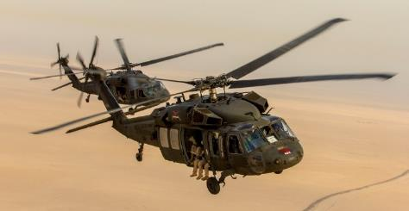
Confirmed: UH-60 vs. DJI Phantom,
Sep 21, 2017; Staten Island, NY
Staten Island

Slide 4
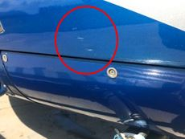

Probable: EC-130 Tour helo vs. unknown drone
Feb 9, 2018, Kauai, HI

Slide 5
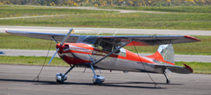
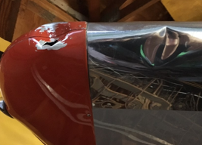
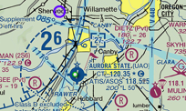
Probable: C-170 vs. unknown drone
May 29, 2018, Aurora, OR

Slide 6


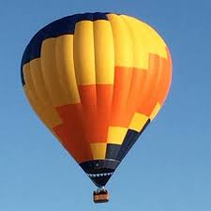
Confirmed: Hot air balloon vs. DJI Mavic 2; Aug 10, 2018, Driggs, ID.

Slide 7
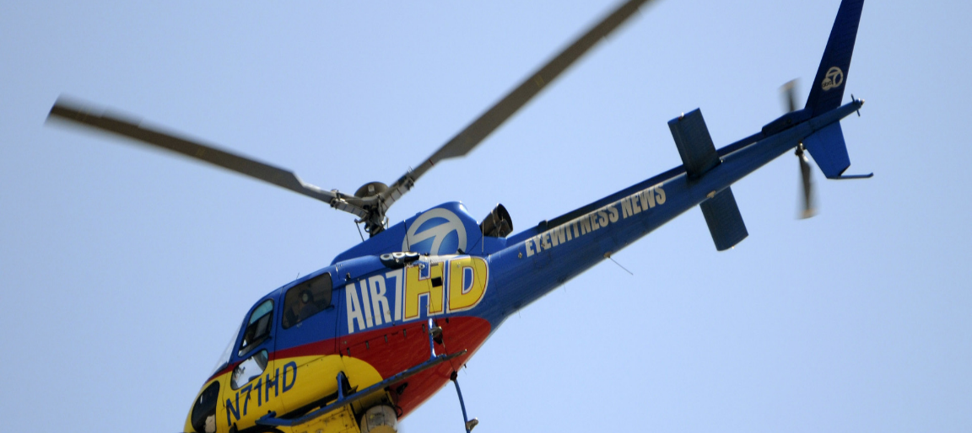
Probable:
Airbus AS-350 vs. Unknown drone , 12/04/19

Slide 8
Probable: Airbus AS-350 vs. Unidentified drone, 12/04/19, Continued.

Slide 9
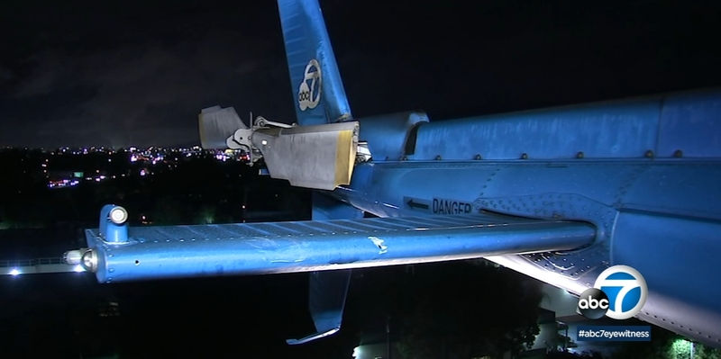
…just a little bit closer and…

Slide 10
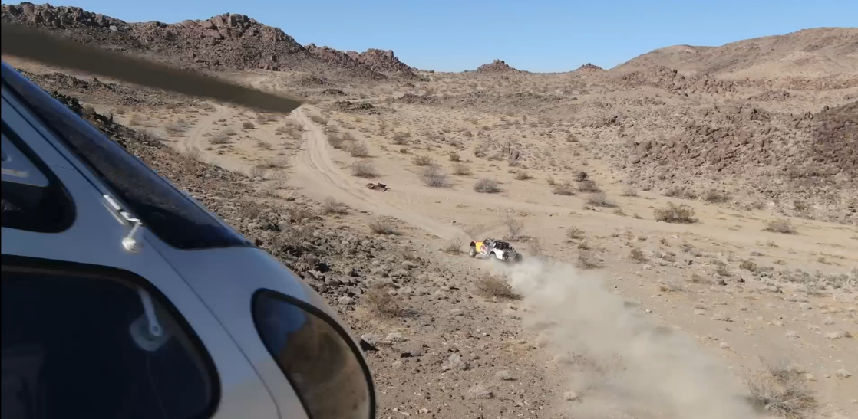
Confirmed:
“King of the Hammers” race, Feb 6, 2020

Slide 11
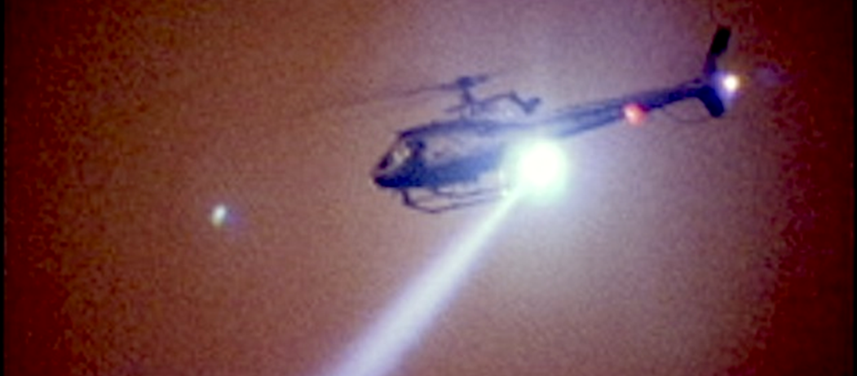
Confirmed:
LAPD Helo vs. DJI, September 18, 2020

Slide 12
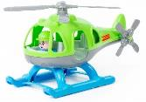

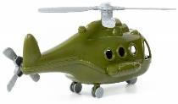
(Does there seem to be a trend, here?)

Slide 13


Slide 14
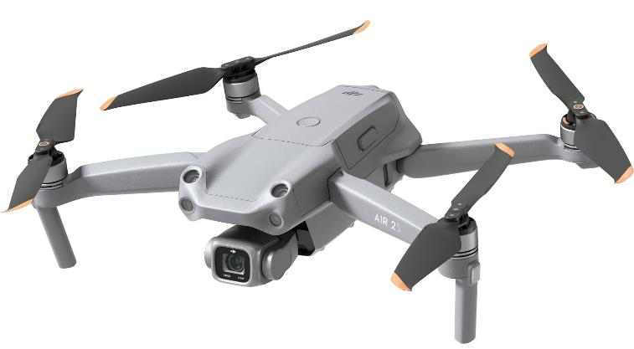

Slide 15
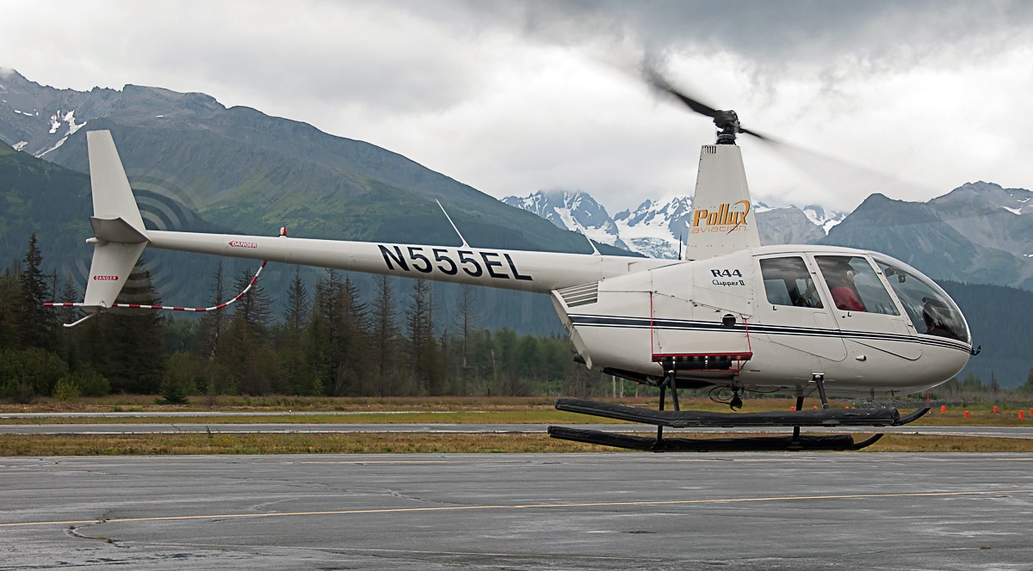

Slide 16

THUD!

Slide 17
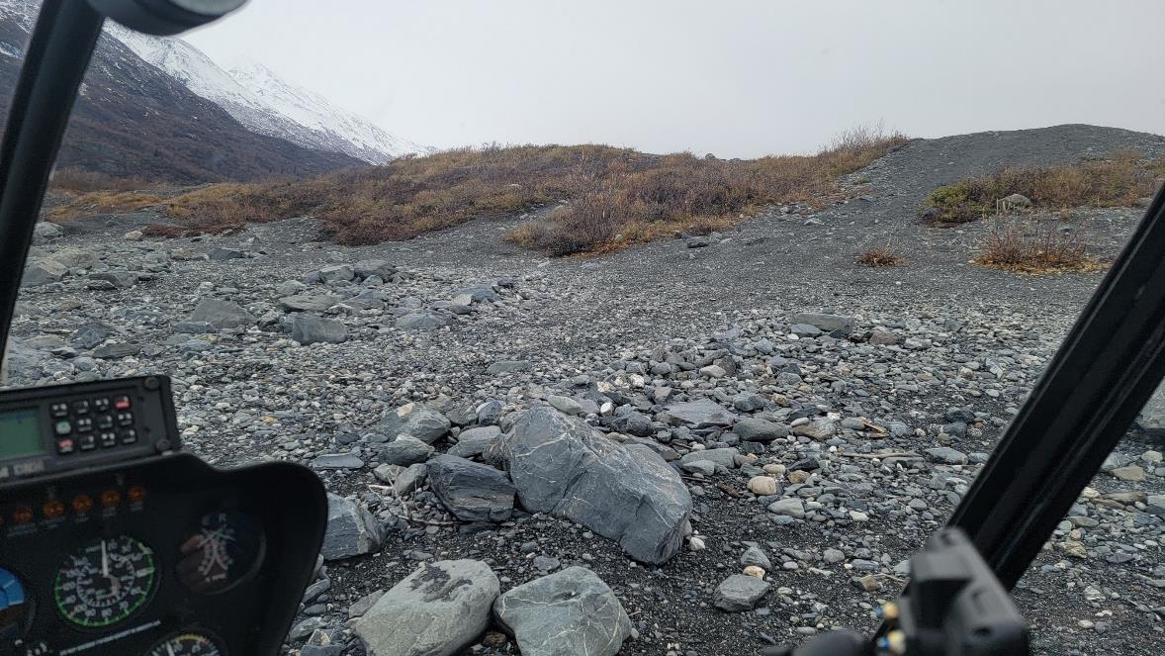

Slide 18
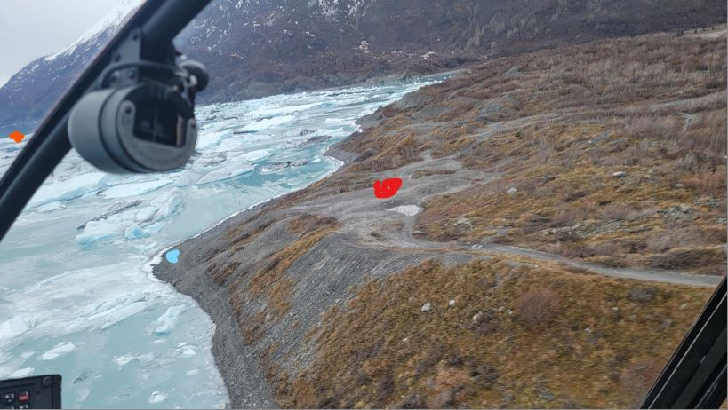

Slide 19

Mishap Rec flyer statement:
Flying his drone below 100 feet AGL
Helicopter “struck his drone” while flying at a “high rate of speed”
Maintains the helicopter was flying “too fast and too low”
“No time to maneuver [the drone] out of the way of the helicopter”
(No airspace warnings or geo-fencing involved)
Wants his drone replaced (i.e., helo is responsible)
Also:
  The Rec Flyer had “never taken any drone training” (TRUST)
  FAA Registration: YES

Slide 20
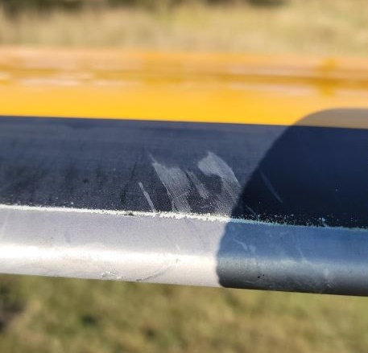
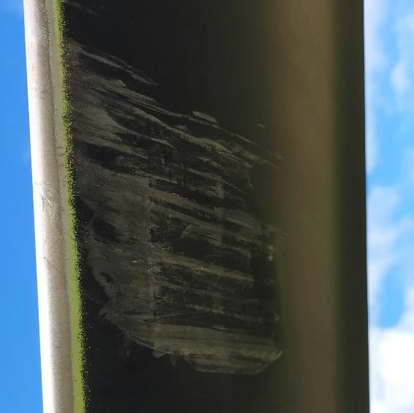
Helicopter blade damage

Slide 21
Investigation Findings
ASI interviewed helicopter PIC, passenger on the helicopter, and the drone operator
Helicopter flying low, hears ‘thud’ on aircraft
Drone flying recreationally under Sec 44809 (but not in compliance; thus Part 107)
Causal factors: 1)Drone operator failed to give way to manned aircraft; 2)Helicopter flying at very low altitude
UAS operator: ASI recommended further education as compliance action. Operator not acting recklessly, but hadn’t taken TRUST and did not avoid the manned aircraft (not selecting adequate observation point, which would have allowed VLOS of “airspace for other air traffic or hazards”) … collision appears to violate Sec. 44809/Part 107

Slide 22
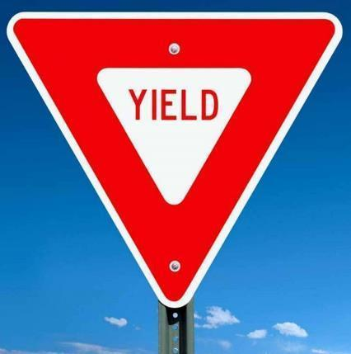
Bearing examination …
Section 44809 (a) (4): The aircraft is operated in a manner that does not interfere with and gives way to any manned aircraft.
The drone operator IS ALWAYS responsible for giving way to manned traffic.

Slide 23

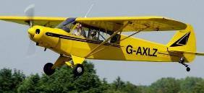
And…
91.119 Minimum safe altitudes: General.
Except when necessary for takeoff or landing, no person may operate an aircraft below the following altitudes:
(a) Anywhere. An altitude allowing, if a power unit fails, an emergency landing without undue hazard to persons or property on the surface.
(b) Over congested areas. Over any congested area of a city, town, or settlement, or over any open air assembly of persons, an altitude of 1,000 feet above the highest obstacle within a horizontal radius of 2,000 feet of the aircraft.
(c) Over other than congested areas. An altitude of 500 feet above the surface, except over open water or sparsely populated areas. In those cases, the aircraft may not be operated closer than 500 feet to any person, vessel, vehicle, or structure.
(d) Helicopters, powered parachutes, and weight-shift-control aircraft. If the operation is conducted without hazard to persons or property on the surface -
(1) A helicopter may be operated at less than the minimums prescribed in paragraph (b) or (c) of this section, provided each person operating the helicopter complies with any routes or altitudes specifically prescribed for helicopters by the FAA; and
(2) A powered parachute or weight-shift-control aircraft may be operated at less than the minimums prescribed in paragraph (c) of this section.

Slide 24

Take-aways
Drone vs. low-altitude Helicopter continues to be the primary encounter scenario
Drone registration is the gateway for introducing operators to regs/NAS safety
Experience and ADM will be continue to be factors
Difficulty in visually acquiring drone (would strobe/bright colors have made a difference?)
The drone operator is always responsible for ‘seeing and avoiding’ manned aircraft, no matter speed or altitude.
  It’s not enough to simply see your drone; need to see surrounding airspace as well to avoid other traffic.

Slide 25
Questions?

Slide 26
What’s the criteria for establishing Visual Line Of Sight (VLOS) under 14 CFR Part 107?
With vision unaided by any device other than eyeglasses, the RPIC must be in a position at all times to see the drone well enough throughout the entire flight, even if a Visual Observer is exercising that ability, to know its
  Location
  Altitude
  Attitude
  Direction of flight
  Observe airspace for other aircraft or hazards
  Not pose a hazard to persons or property (in the air or on the ground)
LAADON

Slide 27
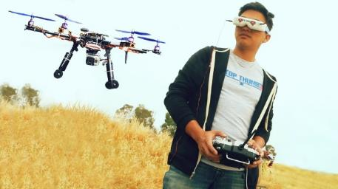
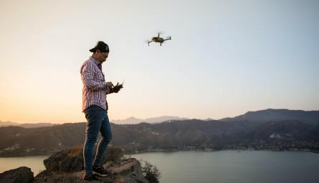
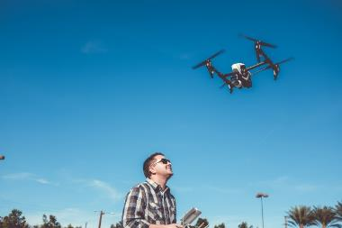
Assuming no Visual Observer is used by these Remote Pilots, are they in compliance with the VLOS criteria of 14 CFR 107.31?
#1
#2
#3

Slide 28
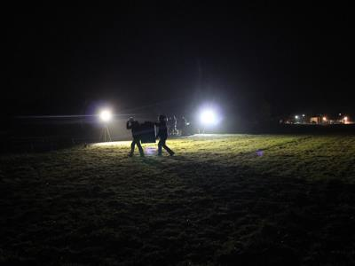
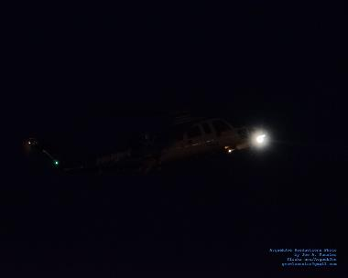
How about now? VLOS?
Drone or a star?
Drone or a high wing manned aircraft?
#4
#5

Slide 29

Do the VLOS criteria of 14 CFR 107.31 change for night?
No
  14 CFR 107.31 is a performance based regulation applicable in ALL conditions, day or night
  Visual acuity is significantly less at night 20/20 vision becomes 20/50 at best (20/200 is legally blind)
  14 CFR 107.29 is an equipage rule
The Anti-Collision Lights (ACL) are required in 107.29 to help manned aviators see and avoid the drone, not for the drone pilot to meet VLOS of 107.31
  ACL and telemetry cannot be used as the primary means of meeting VLOS. (They are not eyeglasses or vision unaided)

Slide 30
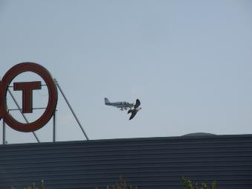
Were they flying a drone, or operating an airborne camera?
At least 6 documented cases of a helicopter vs drone collision
2 probable cases of a small General Aviation aircraft vs drone collision
  In all but one case, the manned pilot did not see the drone before impact
  In all cases the drone pilot did not see enough of the airspace to detect and react in time
    Were they mostly screen watching?
    These were likely violations of 107.23(a), 107.31(a) and (b), 107.37(a) and (b)
Is that a bird, or a drone? Which object is closest to the photographer?

Slide 31
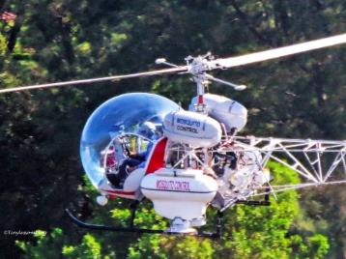
Did you know?
  The camera on the drone will not help you see something that isn’t in the camera’s field of view
  A manned aircraft traveling at 100 Knots groundspeed will cover approximately 170 feet across the ground per second
    Do you see enough of the airspace to detect, identify, and maneuver away in time to avoid a collision?
  Make your drone more visible to the manned pilot
  Use VOs to look behind you and in all directions
  See the preamble to the Final Rule Part 107, Federal Register, 28 June 2016, Volume 81, No. 124, for more insight about VLOS (both day and night)

